Slide 1
The Audio Revolution United States, Europe and China Digital Publishing Summit, Paris June 25, 2019
Lisa Faith Phillips
CDO, China-U.S. Women’s Foundation
LisaFaithPhillips.com

Slide 2
Growing up in Findlay, Ohio, on lazy summer afternoons, I would read aloud to my grandmother who was blind. She would read to me too, her fingers flying over the Braille.
From the deep cushions on her porch, we were transported to magical places.

Slide 3
A voice telling
a great story
or sharing knowledge
touches the soul.

Slide 4
For the last few years a spoken-word revolution has been taking place as transformative technology makes it easy for so many to escape their busy lives listening to a gifted narrator unfold a great story. On the metro, in a car, jogging, or even lulled to sleep at the end of a long day, safe in knowing the app timer will turn it off.

Slide 5
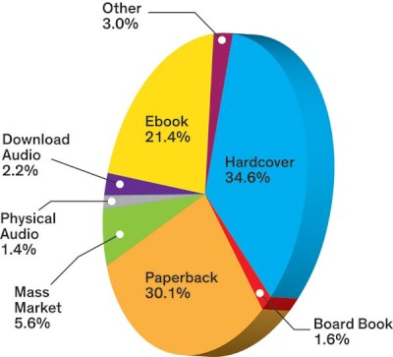
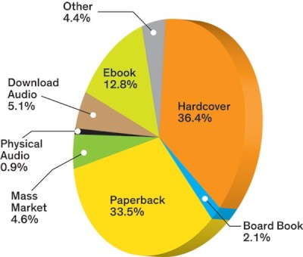
In the U.S. digital audio is the fastest-growing format as listening gets easier
Trade revenue % by format
2013
2017
Double-digit growth for the last six years increased digital audio format share of revenue 123% from 2013 to 2017.
Pie charts from AAP data in PW 8/17/18 “Trade Remained Publishing’s Brightest Spot in 2017”

Slide 6
U.S. digital audiobook sales hit $3.2B in 2018, up 36% in 2018
In the U.S. audiobook listeners read or listened to an average of 15 books in the last year.
Ease of access and innovative content bring in a younger audience, with the majority of people who purchase an audiobook under the age of 45.
57% of audiobook listeners enjoy their books at home.
32% listen to audiobooks in the car.
Source: APA report

Slide 7
Transformative tech increases audiobook consumption
Forbes reported that the number of audiobooks each individual listens to is going up, and that's likely due to tech advancements that are changing listening habits.
73% of listeners used a smartphone to listen to at least one audiobook in 2018.
47% of listeners chose a smartphone as their listening device on a regular basis, up from 29% in 2017.
Source: APA report

Slide 8
In U.K. 49% of audiobook buyers consider themselves heavy buyers
According to Nielsen Book Research, heavy buyers purchase more than 16 audiobooks in a year.
Publishers confirmed to Good e-Reader that 1 out of every 10 books sold is in the audio format, a nice jump from a few years ago. Good e-Reader Global Audiobook Report for 2019
The increase in original content and innovative productions bring good word of mouth and new listeners.
"The audiobook of John Cleese's So, Anyway... is a great example,” said Richard Lennon, editorial director, Penguin Random House Audio, “because it features archive Monty Python material that's never been heard before, as well as lots of ad-libbed material from John that didn't appear in the book. Plus, there is a cameo from Michael Palin. That audiobook has just won gold in the Non-Fiction category at the New York Festivals Radio Program Awards."
Source: Audiobooks are the New Netflix

Slide 9
In China e-book reading up in 2018
In 2018, the Chinese Academy of Press and Publication’s (CAPP) 16th National Reading Survey reported e-book reading was growing again. The annual average number of books read by adults in China is 8*, of which 41% are e-books and 59% paper books.
Like other markets e-books were flat for a few years but e-book reading was up 20% in 2018, with the stated preference for physical books down 7% from 2017.
Source: The National Reading Survey Report: Shen Yizhen
Notes:
*In general China reads much less than other countries but this is a self-reported survey so number of books may be exaggerated. The average Japanese person reads 11 books a year, 9 in South Korea, 7 in the United States and 8 in France, Xinhua reports.

Slide 10
Audiobook listening continues to rise in China
The main drivers are
increasingly busy lifestyle in China
growing desire to learn
ease of access through improved mobile app platforms
Chinese adults report listening in various ways including:
10% use a audio app platform to listen to books
7% listen through the radio
5% listen to audiobooks through WeChat voice.
Source: according to the CAPP annual survey The National Reading Survey Report: Shen Yizhen

Slide 11
Audiobooks are creating a new audience
Unlike e-books, which are often seen as a replacement for the physical book, audiobooks are converting consumers to a new way of experiencing the story.
According to Richard Lennon, editorial director at Penguin Random House Audio, the audience for audiobooks is largely distinct from buyers of print books. And publishers are helping to drive the popularity of audiobooks, not just responding to it. Audiobooks are the New Netflix

Slide 12
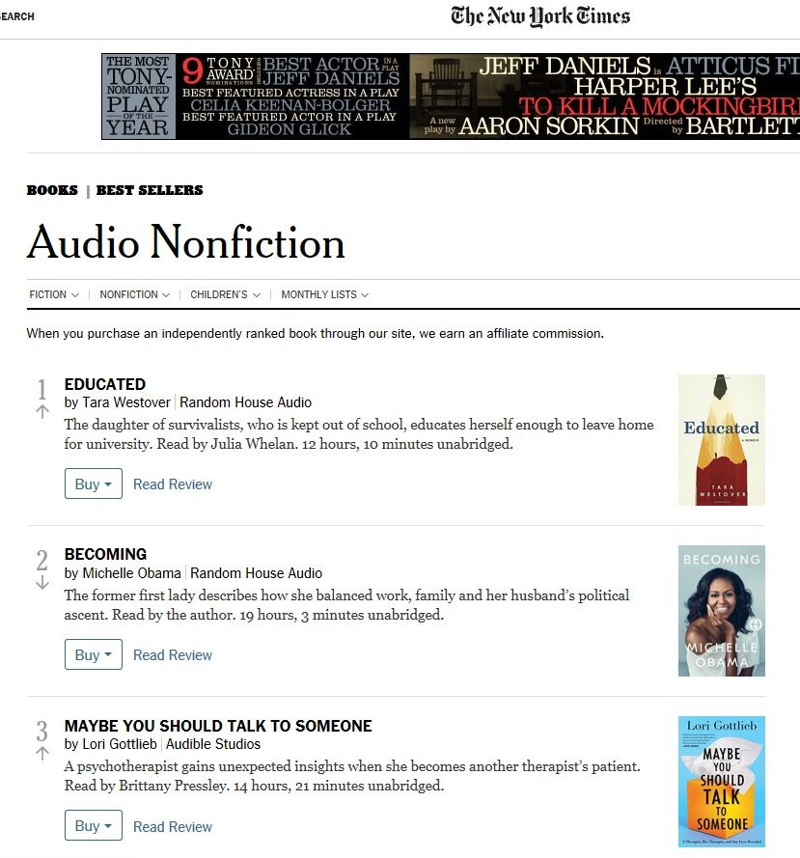
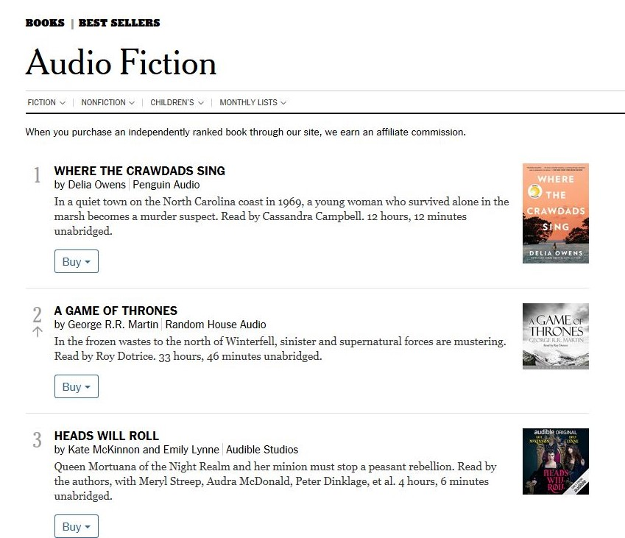
The New York Times promotes audiobook best-sellers monthly
“The vibrant growth of audiobooks in the industry has created a need for an impartial, reliable source for tracking and reporting the top-selling audiobooks across the country,” said Pamela Paul, editor of The New York Times Book Review.
Monthly New York Times audiobook best-seller lists
Notes:
Audible is the new sponsor for a new Sunday Times Audible Short Story Award 2019.

Slide 13
An audio gold rush brings new vendors and consolidation

Slide 14
As Amazon’s e-book/ereader strategy dominated the e-book market
2017 U.S. e-book market vendor share (units)
So it has with the audiobook market.
AAP Sales Reports

Slide 15
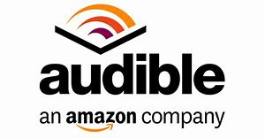
Audible/Amazon builds near-monopoly
Launched in 1995, Audible was bought by Amazon in 2008 for $300 million.
With distribution innovation, marketing power, a low-priced subscription, aggressive publisher deals and creative content, Audible takes over the audiobook market in the U.S.
Some of the innovations that worked and some that didn’t:
2011 - Audiobook Creation Exchange (ACX) connecting rights holders, narrators and producers to create new audiobooks. A year later Audible reported it received more titles from ACX than from its top three audio providers combined.
2012 - Whispersync allows readers to switch seamlessly between reading a Kindle and listening. Immersion Reading lets audiobook read along with highlighted text on a Kindle. Both of these make Audible easy to use on Amazon Echo speakers with launch in 2015.
2012 - A-List Collection showcased Hollywood stars reading classics.
2015 - Former VP of NPR Programming joined to create original content.
2016 - Audible Channels, a podcast platform launched.
2018 - Audible Channels scales down, head of original content steps down and content team downsized.
2019 - Audible Originals given away for free as benefit to paid subscribers.
Source: Wikipedia and Audible
Notes:
As VP of Random House Direct Random House in 2001 I ventured out Audible’s offices in a New Jersey strip mall to begin working with them on testing new ideas as Random House became an early investor.

Slide 16
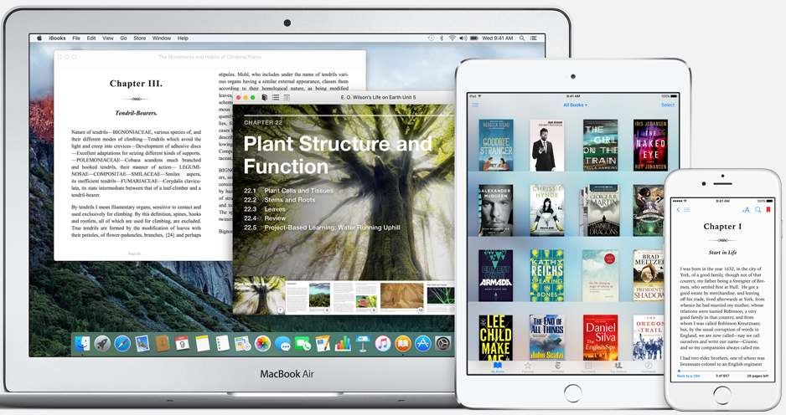
With only 8% of the U.S. market and poor discovery, Apple’s audiobook sales have been low
With the end of Audible/Amazon/Apple exclusive agreement in late 2017 and the end of iTunes in 2019, we’re seeing a new push from Apple for the growing speaker market.

Slide 17
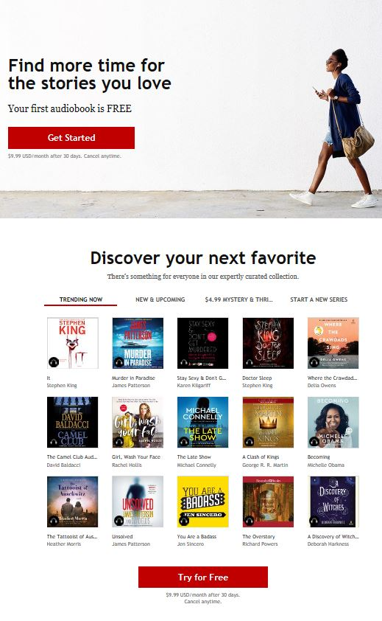
In late 2017, Kobo’s launches with a less expensive subscription offer
Kobo launched their own audiobook service in late 2017.
Their competitive advantage is a 30% lower monthly subscription price though with a smaller catalog than Audible. Powered by Overdrive and both owned by Rakuten, it provides synergy.
In early 2018 Kobo Originals launched for both audiobooks and e-books.
Working with publishers and industry partners, Kobo is focusing on customers in France, the Netherlands and Canada.
Notes:
LibriVox great selection of public domain audiobooks to download for free
In contrast to Audible, LibriVox is completely free of charge. Classics with less well-known narrators.

Slide 18
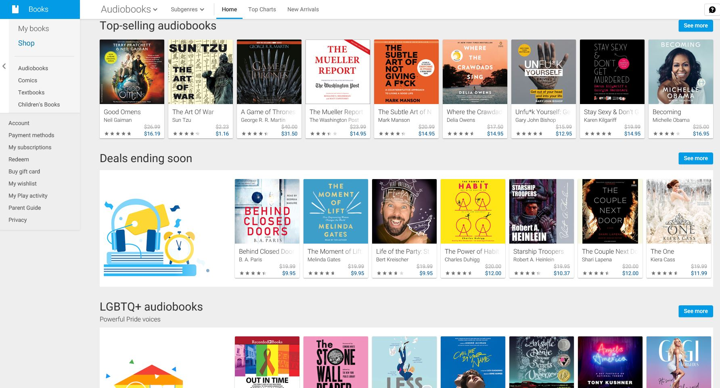
In 2018, to grow their smart speaker market, Google enters audiobooks
Google Audiobooks
The latest addition to the Google Play Store, the new service promotes individual sales, with 50% off your first purchase and limited-time deals. There is no-subscription service.
Available in 45 different countries and 9 different languages
Notes:
Google’s Home speakers have lagged Amazon Echo in terms of audiobook features. Amazon-owned Audible, the top provider of audiobooks, has not been supported on Home and other speakers with Google Assistant.

Slide 19
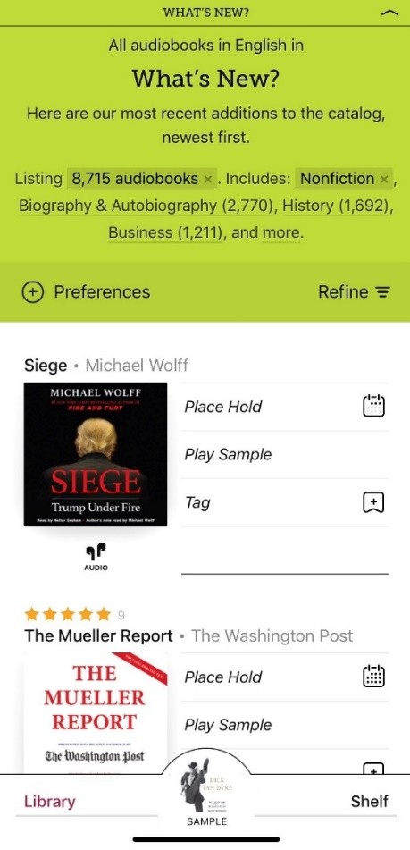
In U.S. public libraries build audiobook audiences
In 2017, approximately 68 million audiobooks were borrowed from libraries and schools in the United States.
52% said borrowing from libraries was very important to discovery.
43% of listeners downloaded an audiobook from a library.
Hoopla, Biblioteca and other new vendors build out library distribution.
14% of listeners said they most often use the library for their digital listening.
Audiobook Publishers Association and Edison Research
Notes:
When I first started working on digital library in the U.S. while at Random House, figuring out how to download from the library was a lengthy awkward process. Now new apps make it easy for the listener to discover and download. There can be a long wait time at busy libraries as it is one file one user.

Slide 20
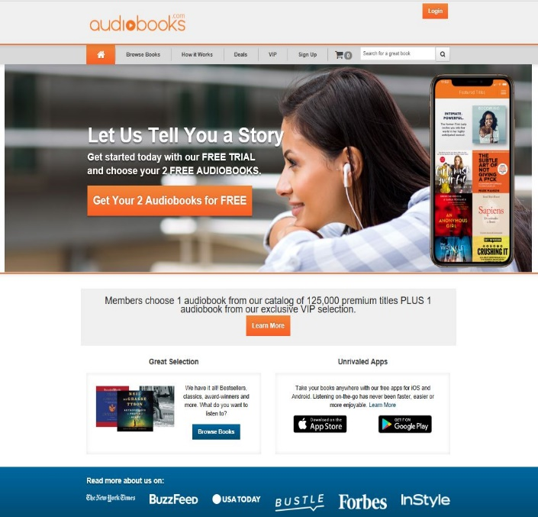
Mergers and consolidation
In 2017 Audiobooks.com, the largest competitor to Audible, was acquired by RBmedia, a new conglomerate led by Recorded Books.
With new funding Audiobooks.com expanded into Australia and the United Kingdom.
In July 2018, RBMedia was sold to private equity firm KKR.
“We love the industry sector and its growth, and we think it will continue,” said Richard Sarnoff, chairman of media, entertainment, and education for KKR, in an interview. “Audiobooks create incremental time for enjoying great books, and one thing we lack today is time. We think this type of content will continue to take up more mind share, especially among younger consumers.”
* Good e-Reader Global Audiobook Report for 2019

Slide 21
Smart speakers jet-propel audio revolution

Slide 22
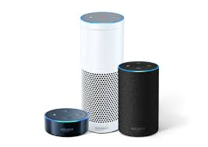
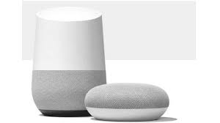
Smart speakers take off
In 2018, 41% of U.S. consumers own a voice-activated speaker, up from 22% in 2017.
Amazon Echos
Google Home
RBC Capital Markets analysts, December 2018
By 2020, 50% of all searches across the internet will be voice-based, and 30% of all searches will be done without a screen. [QuoraCreative]
Notes:
The biggest change with the Apple’s Podcast app uses machine learning technology to index words that are spoken during podcasts. This means, when you want to find a podcast based on specific themes or topics discussed, you can search using these words. Amazon's Alexa platform is propelled by the Smart Home Skill API, which allows third-party developers to create apps without needing native support.
In June 2018, Simon & Schuster announced the “first voice-activated audiobook recommendation tool” for audiobooks on smart speakers for the “Stephen King Library.”
Amazon Alexa and Google Assistant users in the United States and Canada can download the free “Stephen King Library” onto their smart speaker platforms that will recommend Stephen King books, tailored to the users’ reading tastes.

Slide 23
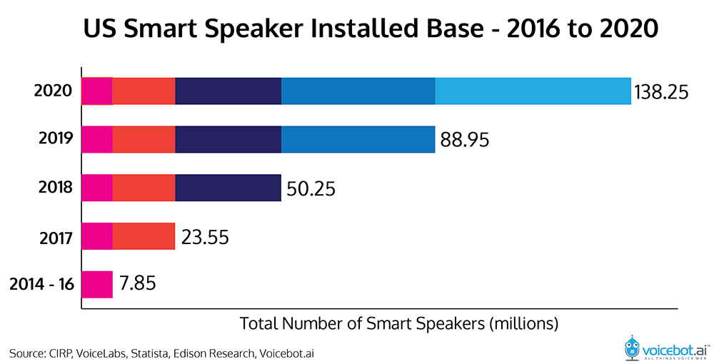
Sales of smart speakers expected to more than double by 2020

Slide 24
Smart speakers spark new content and innovation
In 2017, the BBC with Rosina Sound created a successful choose-your-own adventure series with The Inspection Chamber.
Users guide it by answering questions, which become part of the narrative helping to make the whole experience immersive.
BBC
Hachette Book Group developed Classroom 13 Skill, a choose-your-own-adventure series.
Created specifically for Alexa and the Echo device and adapted from the popular illustrated kid’s chapter book series, it is activated and controlled by voice commands directed at Alexa to initiate the interactive adventure.

Slide 25
Smart speakers create new market for short form audio content
Publishers are repurposing audio book content into short audio segments that work for daily or frequent sending.
This works especially well for
Inspirational daily affirmations
Self-help advice
Christian devotionals from such publishing best-sellers as Sarah Young and Joel Osteen.
Publishers adding call-to-actions to drive purchase of the book but with limited success.

Slide 26
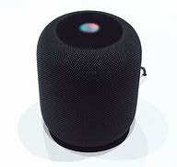
Concerns about smart speaker effect on competition
On May 28, 2019, the Hadopi and the CSA published a joint study on voice-assisted speakers and the market impact.
With Amazon, Google and Apple, dominating the market, there is the clear risk that they will give preference to their own services, limiting access of other players.
Especially with the lack of visual transparency, it will be difficult to monitor the voice’s access to diverse sources.
Government oversight will be needed to ensure that small players have access to this market.
Source: Hadopi
Apple Homepod
Google Home
Amazon Echos

Slide 27
Podcasting – spoken word on demand is the hot new thing

Slide 28
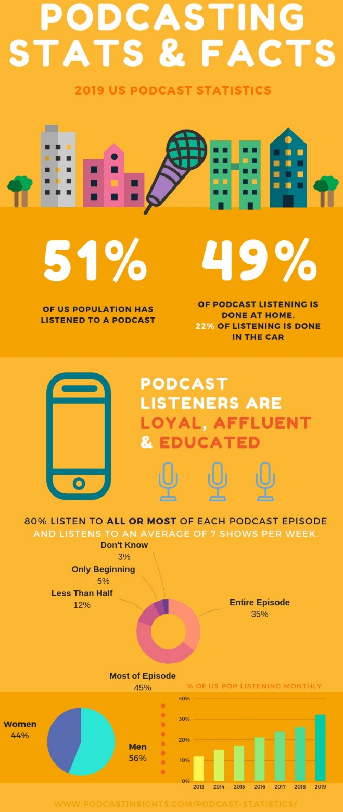
Podcast interest explodes
In 2019, there are over 750,000 podcasts in the U.S.
38+ million people listen to podcasts every week in 2019.
Apple reports 50 billion all-time record in 2018, download volume is an exponential increase from the 13.7 billion reported downloads in 2017
Source PodcastsInsights.com

Slide 29
Lots of great podcasts but what business model?
Free as gateway to purchase
Advertising supported
Donation supported – National Public Radio
Subscription
Micro-payments – works well in China
Tipping – Himalaya.com is testing
Notes:
Evolving business models

Slide 30
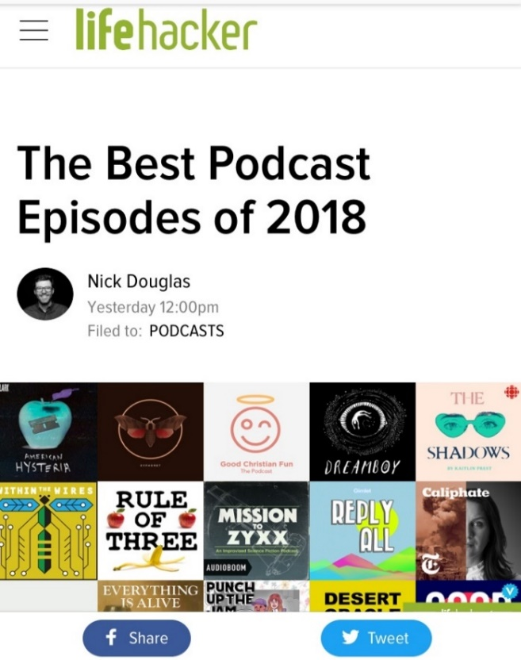
Free podcasts are a gateway to purchase
Retail companies see podcasts as a gateway to buying.
For audiobooks, Audible, Overdrive and Scribd have all launched their own in-house podcast unit to build their brand.
The strategy -- if you excite the consumer with good free content, they will end up purchasing a subscription or additional audiobooks.
* Global Audiobook Trends and Statistics for 2018 by Michael Kozlowki

Slide 31
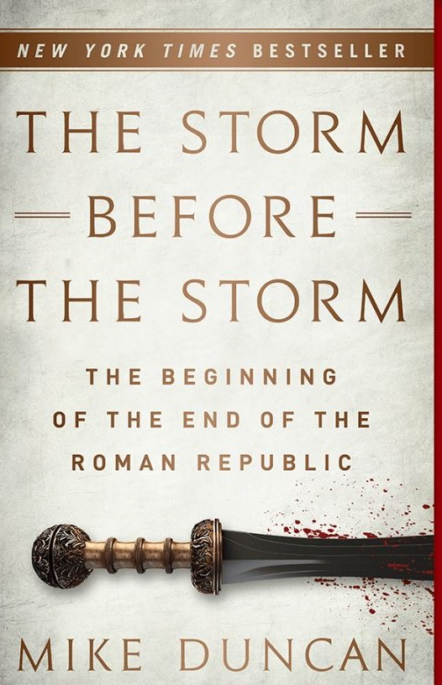
Podcasts can convert to book sales
Jamie Leifer, associate publisher of PublicAffairs, found remarkable advance sales for The Storm Before the Storm: The Beginning of the End of the Roman Republic by Mike Duncan.
The author has developed a large following as host of “The History of Rome” and “Revolutions.” podcasts.

Slide 32
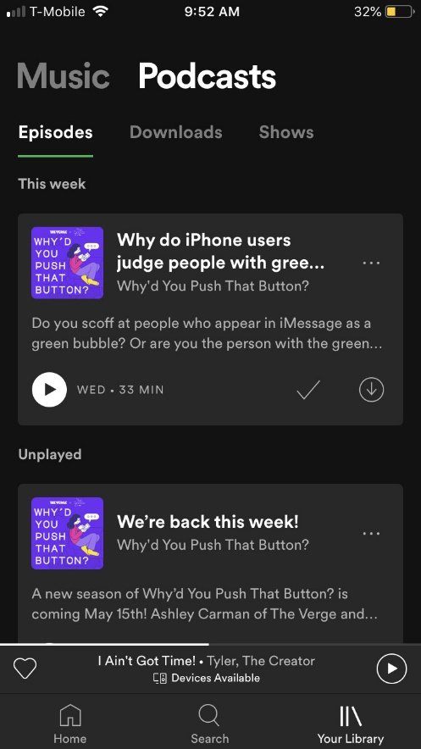
Platforms innovate and merge for improved podcast experience
In June 2019, Spotify rolled out a new design for premium users of podcasts with three sections: episodes, downloads, and shows to make it easier to manage listening.
Other Spotify improvements include:
first playlist with incorporated podcasts
a web app for creating shows
first hardware product to study audio consumption in the car
Source: The Verge

Slide 33
Investors gambling on new podcast platforms
In April 2019, Luminary, a new podcast platform, launched with $100M investment. Will their emphasis on original and exclusive content get people to pay a $7.99/monthly subscription?
They are up against other lower-priced podcast subscriptions already on the market, Stitcher ($4.99 a month) and Wondery ($5 a month) and free offerings from Apple and Google.
Luminary’s large advertising budget gets the word out. In June, they covered NYC subway with promotions.
Spring is full of reports of content providers backing out.

Slide 34
China’s audio industry FOMO effect
In 2018, Marketplace reported that audio “podcasts”, which are primarily self-improvement lectures, are part of a $7.3 billion industry FOMO, or the “fear of missing out.”
These “pay-for-knowledge” online education with interactive Q&A’s with experts or celebrities where the consumer can participate and pay subscription fees or micro-payments, made easy by pay by phone.
Audio consumers use Ximalaya FM, China’s largest audiobook distributor with 70% of China’s audiobooks. With the growth of podcast knowledge-sharing, and a self-reported 400 million app downloads, advertising, micro-payments and subscriptions has built Ximalaya FM to a $2.3B valuation.
In comparison, the U.S. podcast industry mostly makes money through advertising with a reported $314 million ad revenue in 2017 Interactive Advertising Bureau.
A popular is a podcast with 218,000 subscribers is “How to Make Your Voice More Attractive” to help Chinese lose their rural accents and improve their economic chances in the big cities.

Slide 35
China highly regulates the market
Although there are personal mission-driven podcasts being created in China, Yi Yang (杨一), a senior editor at a Chinese TV business network and podcast specialist, explained in a recent Neiman Lab report that it is harder to build your own podcast and distribute it in China.
Due to the lengthy approval processes by the Chinese local public security and Internet administration to build websites and servers, it is easier to turn to audio platforms such as Ximalaya FM.
However, Ximalaya FM’s proprietary content will be favored over uploaders.
Ximalaya FM brings together hosting services, program distributors, and RSS subscriber applications, but they also insert commercials in the programs the podcaster uploads, without sharing the profits, and can remove content deemed inappropriate.

Slide 36
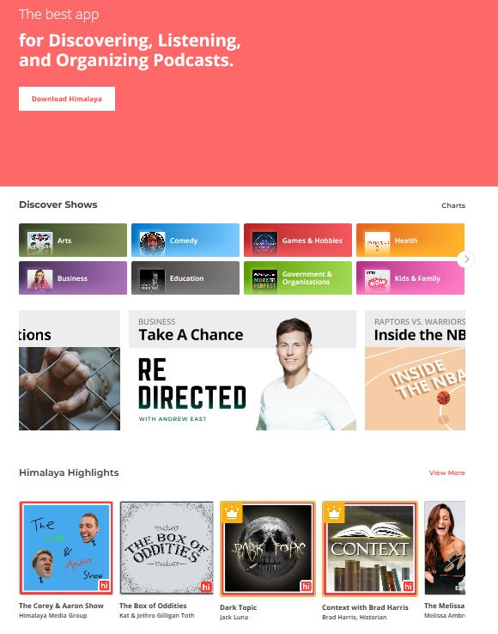
In 2019, China invests big in U.S. podcasting
In February 2019, Himalaya Media raised $100 million to launch their new podcast site in the U.S. Himalaya.com offers original and existing content with a “tipping” model of small payments to your preferred podcasts, which works in China.
Setting up Himalaya as an independent entity based in San Francisco is a strategic due to the current tension between the U.S. and China, as well as concerns of censorship.
Variety notes they may want to distant themselves from their main Chinese investor Ximalaya FM’s launch of a dedicated version of its smart speaker for members of the Chinese communist party.
Source: Variety

Slide 37
Where is the future of audio going?
More inventive original content and productions
More celebrity voices as narrators
Testing different business models: subscriptions, micro-payments, "tipping”, single purchase
Aggregation of audio and podcast companies for growth
Greater content integration with social media
Innovations in voice SEO
Distribution channel improvements for consumer ease and adoption

Slide 38
Authors, publishers and disrupters will continue to innovate to bring the magic of storytelling to evolving transmedia channels that fit our more hectic lives.

Slide 39
Any questions? LisaFaithPhillips.com lisafaithphillips@gmail.com
Thank you!

